Slide 1
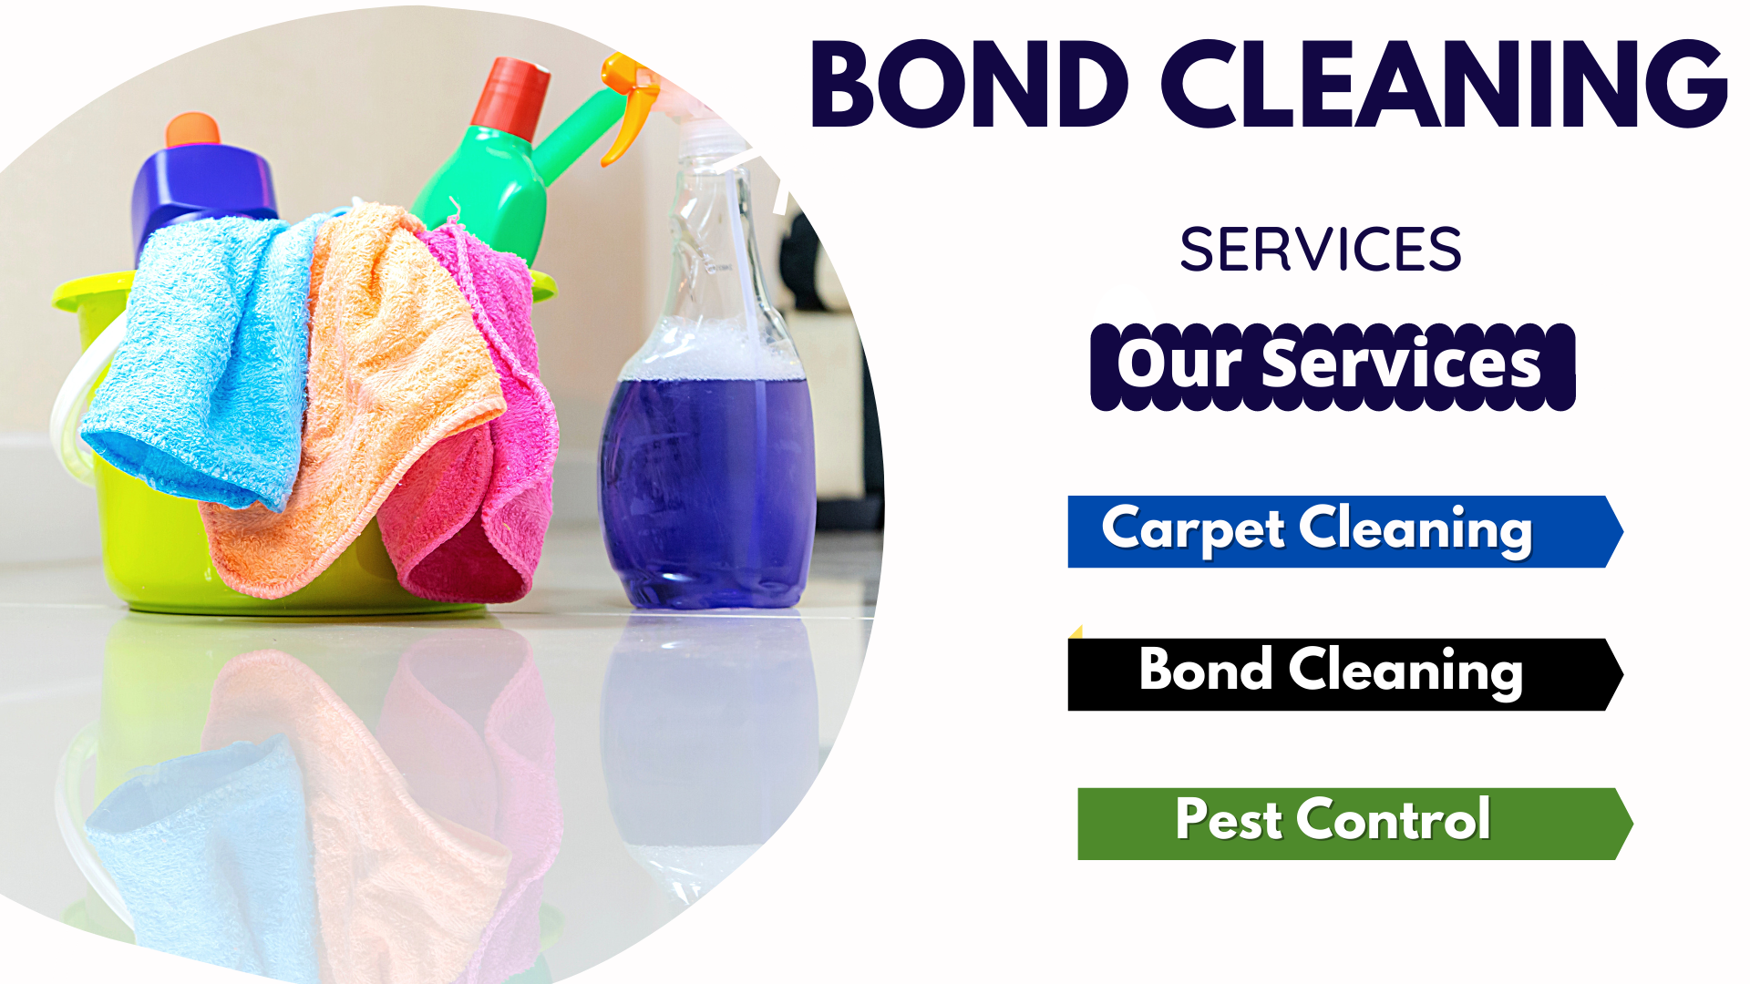
Bond Clean Co

Slide 2
We know that cleaning is very important in our houses, offices, if you are faced the problem with cleaning and you looking at best bond cleaning company in Australia.
We are running a best bond cleaning company in Australia many years his named “Bond Clean Co”.
We are provide our customer high quality cleaning services at low cost, our cleaning services are not limited like Bond Cleaning Brisbane which include office cleaning, home cleaning, carpet cleaning, pest control services.
We are having highly trained and skilled cleaner they always ready to help you, Our works will reach your houses early after your order and provide you with amazing service. Our staff known the value of our client so they work on time, Bond cleaning extends the life of your furniture.

Slide 3
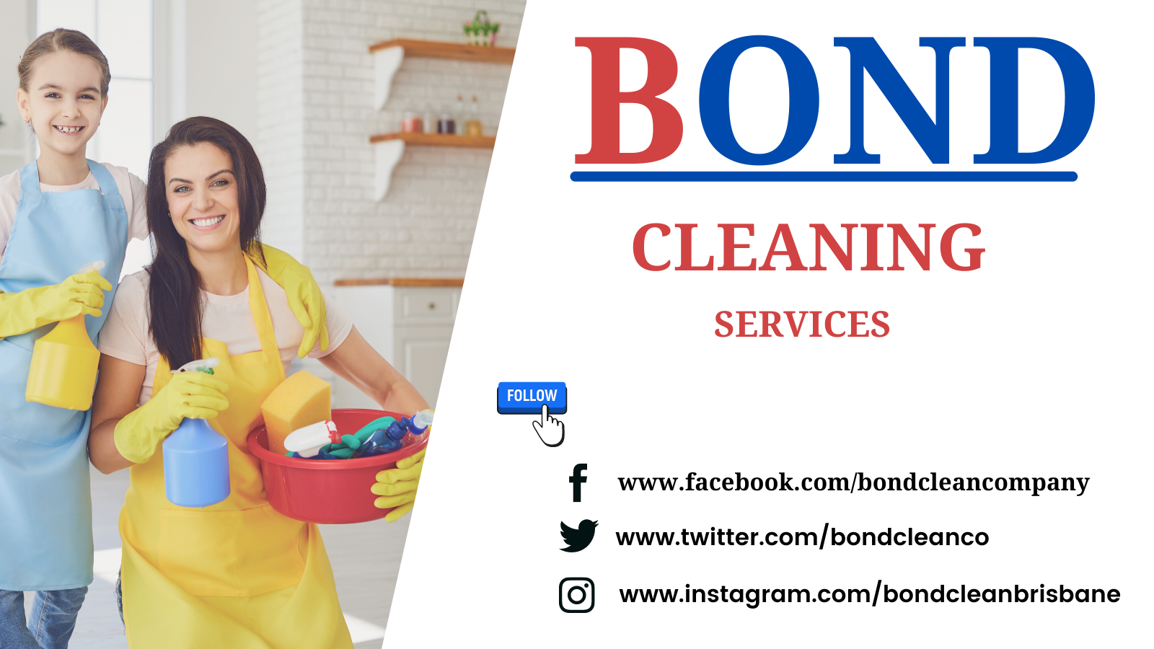
Bond Cleaning Brisbane

Slide 4
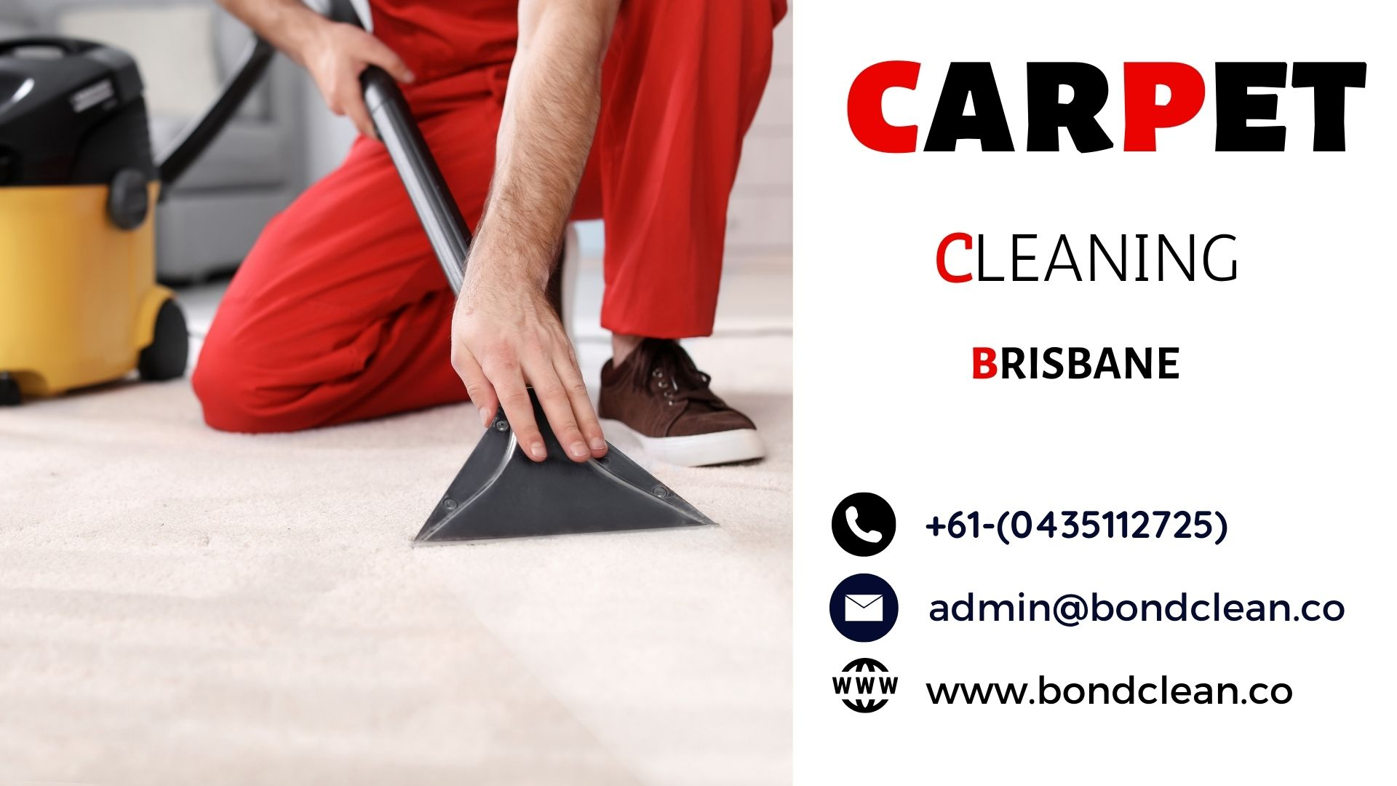
Carpet Cleaning Brisbane

Slide 5
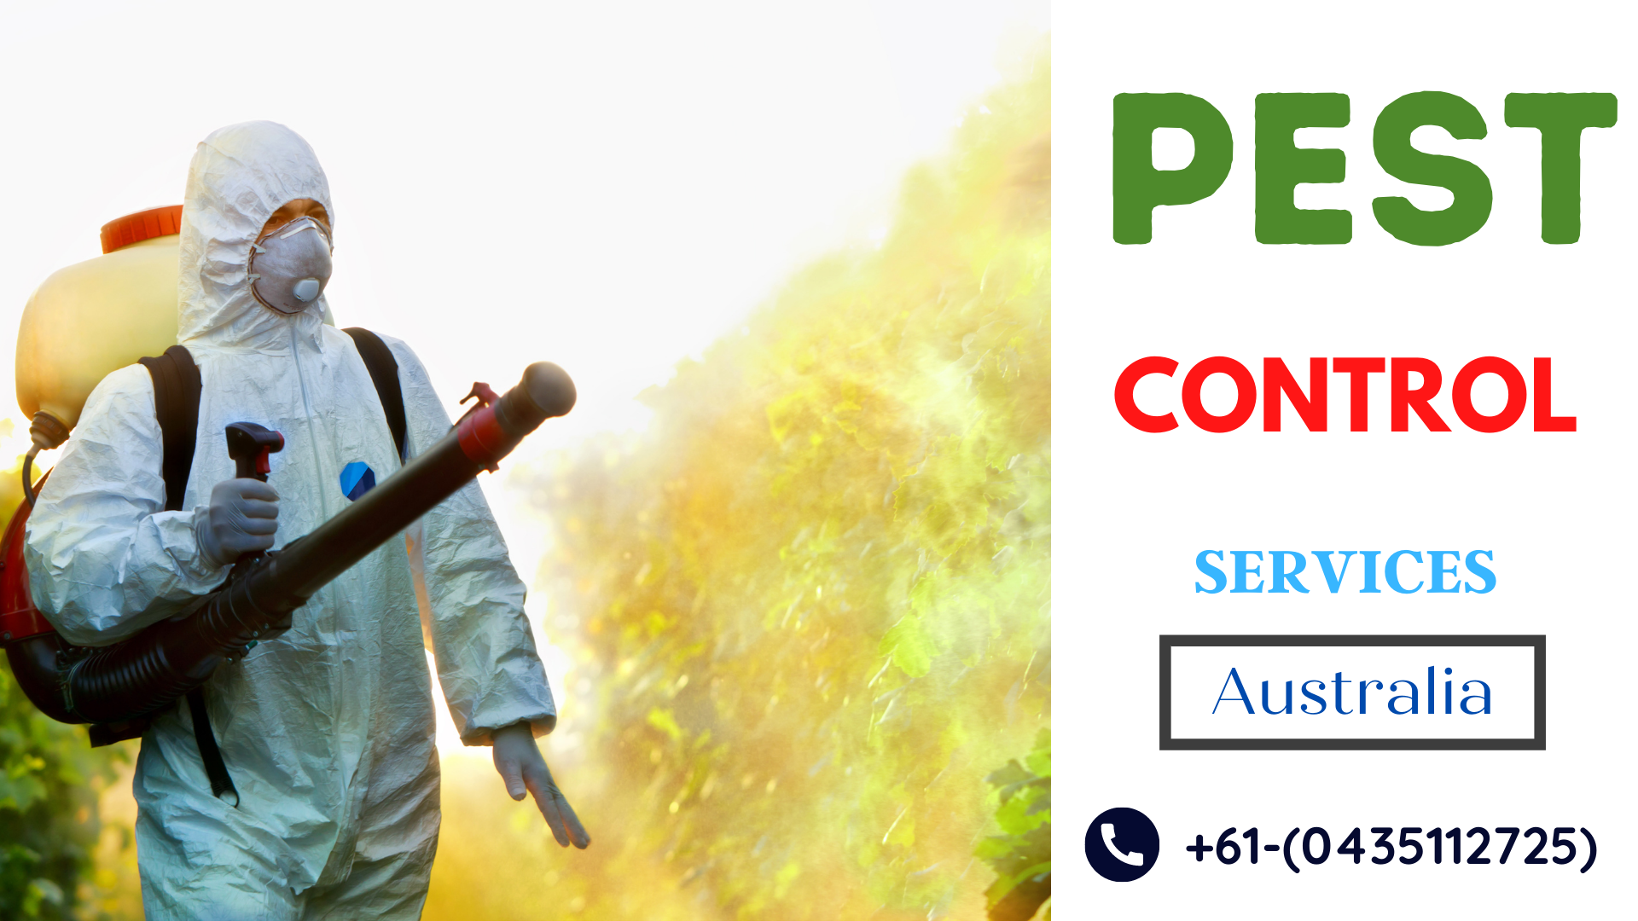
Pest Control Brisbane

Slide 6

Thank You For Watching

