Slide 1
BOND CLEANING SERVICES
CARPET CLEANING
HOME CLEANING
PEST CONTROL

Slide 2
BOND CLEAN CO
HOME
CLEANING
SERVCIES

Slide 3
CARPET CLEANING

Slide 4
PEST CONTROL SERVICES

Slide 5
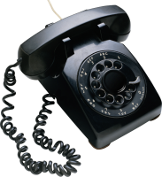
Call To US
0435112725
admin@bondclean.co
www.bondclean.co

