Slide 1



EVERY START-UP
OPT FOR
SEO SERVICES
DIGITAL SOLUTIONS FOR A DIGITAL TOMORROW!

Slide 2

Most start-ups and small businesses often miss the trick to expand their business at an early stage. Business owners think they can do SEO during the latter part of the business expansion.
But this usually results in a delay in growth as well as customer interaction and acquisition.
Hence, new ventures need to opt for an affordable SEO company in Delhi when they decide to build a site. This will help them develop the correct reputation and authority by ranking higher in the Google SERP.

Slide 3


Reasons to Opt For an Affordable SEO Firm
Optimizing a website for SERP is a powerful move when launching a start-up. Additionally, if business owners opt for an affordable SEO company, it will not hamper the budget as well. But why SEO is important for new ventures?
Here are the reasons:
SEO Provides Results for Start-Ups
Optimizing for Google Increases Trustworthiness SEO Experts Help in Taking Correct Decisions SEO Improves Traffic and Conversion
SEO Delivers Customer Behavior Data

Slide 4


SEO Provides Results for Start-Ups
According to Nasdaq, by 2040, about 95% of purchases will be operated online. Thus, it is evident why building a digital presence is vital for a start-up in the current scenario. This is also one of the best ways to access data about the audience.
SEO Agency Goals
The purpose of SEO is greater than simply driving traffic to your website from search engines.
Actually, depending on your business goals, an SEO strategy that brings less traffic, but the right kind of traffic, can ultimately help you more.

Slide 5


Optimizing for Google Increases Integrity
Google.com is the most visited website on the planet, with over 1 billion monthly users.
Additionally, in 2020, Google recorded 6.9 billion searches per day and 2.5 trillion searches per year.
After ranking high in Google, a business can now move to build its credibility and trust. Hence, here SEO assistance for start-ups can help considerably.

Slide 6



SEO Experts Help in Taking Right Decisions
Through the help of SEO, businesses can collect data about customer behavior. Some of the data collected are user behavior, conversation rate optimization, content performance, engagement, accessibility, and others.
With this data, businesses can detect the flaws can learn how to use the navigation to expand their business. Thus opting for an affordable SEO company in Delhi can help develop a business from its seed stage.

Slide 7

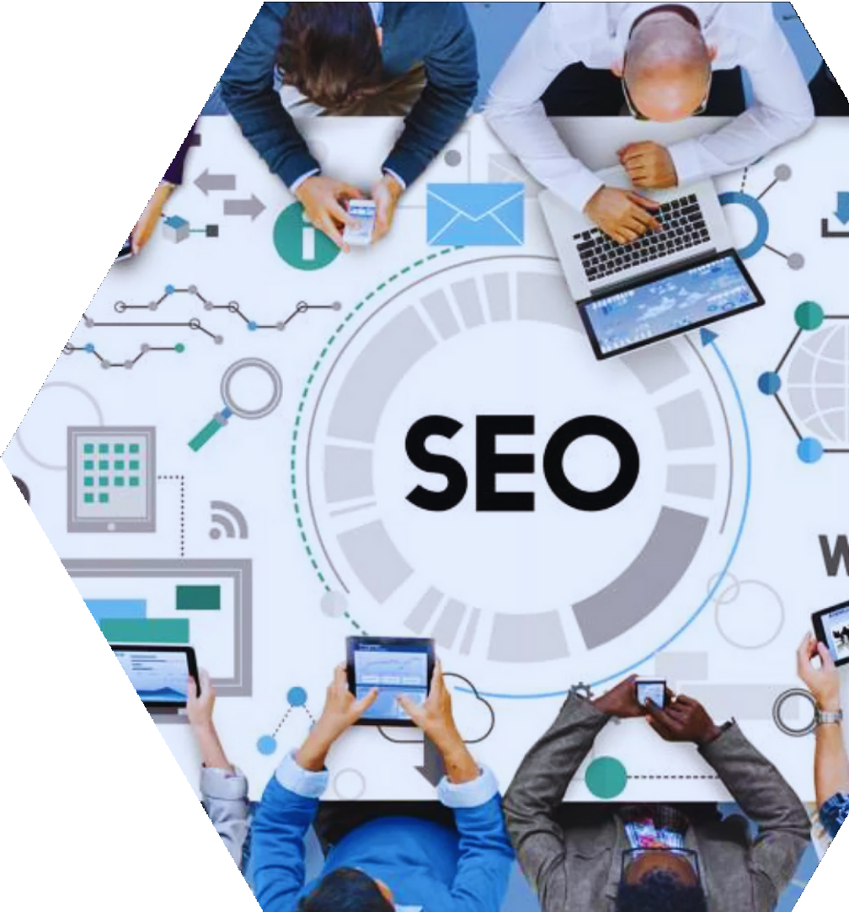

SEO Improves Traffic and Conversion
Properly optimizing a website can fetch considerable traffic for a business. As reported by Moz, the first page of Google gets 71% traffic clicks and has skyrocketed to 92% in recent years. In comparison, the second page only gets about 6% clicks.
Thus, ranking on the first page can boost a business considerably by yielding conversions and revenue.
Thus, an affordable SEO company Delhi can increase business and enhance customer interaction.

Slide 8


SEO Delivers Customer Behavior Data
SEO can unravel essential customer data. The more finely a business does SEO, the more precise result it can fetch from it. Later, this data can be very handy to progress and decide the future steps of a new business.
From the above pointers, it is evident why SEO services are essential for a start-up. Thus, opting for an affordable SEO company in Delhi is beneficial to increase its business and sustain it in this digital world.

Slide 9


Contact
ESIGN WEB SERVICES
Email:
support@esignwebservices.in
Website:
https://www.esignwebservices.in
Call Us:
+91-9718099999
facebook.com/esignwebservices.in

